Slide 1


Microservices with Spring Cloud Netflix
Date: 27th May, 2016

Slide 2
Table of Contents
1
Microservices Architecture with Spring Cloud Netflix
2
Spring Cloud Netflix
3
Gradle
4
YAML
5
Spring Boot
6
Eureka

Slide 3
Table of Contents
7
Spring Cloud Config
8
Zuul
9
Hystrix
10
Turbine
11
Configure Microservices with Spring Cloud Netflix

Slide 4
Microservices Architecture with Spring Cloud Netflix
EDGE Server
(Zuul)
Load balancer
(Ribbon)
Monitoring Dashboard
(Hystrix Dashboard + Turbine)
Service A
Composite Service
(Instance 1)
Service A
Composite Service
(Instance 2)
Composite Services
Eureka Client
Eureka Client
Service Registry
(Eureka Server)
Circuit Breaker
Hystrix
Load Balance
Ribbon
Circuit Breaker
Hystrix
Load Balance
Ribbon
Spring Cloud Config Server
Core Services
Service B
(Instance 1)
Service B
(Instance 2)
Service C
(Instance 1)
Service C
(Instance 2)
Eureka Client
Eureka Client
Eureka Client
Eureka Client
Mongo DB

Slide 5
Spring Cloud Netflix
Spring Cloud Netflix provides Netflix OSS integrations for Spring Boot apps through auto configuration and binding to the Spring Environment and other Spring programming model idioms. With a few simple annotations you can quickly enable and configure the common patterns inside your application and build large distributed systems with battle-tested Netflix components.
Features
Eureka: Service Discovery - instances can be registered and clients can discover the instances using Spring-managed beans
Ribbon: Client Side Load Balancer
Config Server: External Configuration
Zuul: Router, Filter and Server side Load Balancer
Feign: Declarative REST Client - creates a dynamic implementation of an interface decorated with JAX-RS or Spring MVC annotations
Hystrix: Circuit Breaker - clients can be built with a simple annotation-driven method decorator
Turbine: Event stream aggregator for Hystrix Dashboard
For content

Slide 6
Gradle
Gradle is an open source build automation system that builds upon the concepts of Apache Ant and Apache Maven
Java folder structure for Gradle
└── src
└── main
└── java
└── package structure
└── resources
└── src
└── test
└── java
└── package structure
└── resources

Slide 7
Gradle
Install Gradle
Gradle is downloadable as a zip file at http://www.gradle.org/downloads.
Unzip the file to your computer, and add the bin folder to your path.
To test the Gradle installation, run Gradle from the command-line: gradle
To check the tasks available in gradle run from the command-line: gradle tasks
Create a simple HelloWorld.java inside the folder structure with a package name of your choice
package com.cg;
public class HelloWorld {
public static void main(String[] args) {
System.out.println(“Hello World!”);
}
}

Slide 8
Gradle
build.gradle
build.gradle is a file that contains information about the project and configuration details used by Gradle to build the project like build.xml for Ant and pom.xml for Maven.
Create a very basic build.gradle file in the root folder of the project that has only one line in it:
apply plugin: 'java‘
Go to the project folder in command-line and on running gradle tasks again, and you see new tasks added to the list, including tasks for building the project, creating JavaDoc, and running tests.
The gradle build task compiles, tests, and assembles the code into a JAR file:
gradle build
After a few seconds, "BUILD SUCCESSFUL" indicates that the build has completed.

Slide 9
Gradle
After the successful build, a build folder is created in the project directory which contains several directories created by gradle depending on the build script
The project can be run using the following command:
gradle run
Hello World!
This indicates a successful run for this project
Declare Dependencies
The simple Hello World sample is completely self-contained and does not depend on any additional libraries. Most applications, however, depend on external libraries to handle common and/or complex functionality.

Slide 10
Gradle
For example, suppose that in addition to saying "Hello World!", you want the application to print the current date and time. You could use the date and time facilities in the native Java libraries, but you can make things more interesting by using the Joda Time libraries.
First, change HelloWorld.java to look like this:
package com.cg;
import org.joda.time.LocalTime;
public class HelloWorld {
public static void main(String[] args) {
LocalTime currentTime = new LocalTime();
System.out.println("The current local time is: " + currentTime);
System.out.println(“Hello World!”);
}
}

Slide 11
Gradle
If you ran gradle build to build the project now, the build would fail because you have not declared Joda Time as a compile dependency in the build.
repositories {
mavenCentral()
}
The repositories block indicates that the build should resolve its dependencies from the Maven Central repository. Gradle leans heavily on many conventions and facilities established by the Maven build tool, including the option of using Maven Central as a source of library dependencies.

Slide 12
Gradle
sourceCompatibility = 1.8
targetCompatibility = 1.8
dependencies {
compile "joda-time:joda-time:2.2"
}
With the dependencies block, declare a single dependency for Joda Time. Specifically, asking for (reading right to left) version 2.2 of the joda-time library, in the joda-time group.
It is a compile dependency, indicating that it should be available during compile-time
Other notable types of dependencies include:
providedCompile: Required dependencies for compiling the project code, but that will be provided at runtime by a container running the code (for example, the Java Servlet API).
testCompile: Dependencies used for compiling and running tests, but not required for building or running the project’s runtime code.

Slide 13
Gradle
sourceCompatibility is "Java version compatibility to use when compiling Java source." targetCompatibility is "Java version to generate classes for.“
On running gradle build, Gradle will resolve the Joda Time dependency from the Maven Central repository and the build will succeed.
On executing gradle run successfully:
The current local time is: 13:16:10.744
Hello world!

Slide 14
YAML
YAML is a human-readable data serialization language that takes concepts from programming languages such as C, Perl, and Python, and ideas from XML and the data format of electronic mail.
YAML is a recursive acronym for "YAML Ain't Markup Language“ to distinguish its purpose as data-oriented, rather than document markup.
A recursive acronym is an acronym that refers to itself. A markup language is a system for annotating a document in a way that is syntactically distinguishable from the text.
YAML syntax was designed to be easily mapped to data types common to most high-level languages
Its familiar indented outline and lean appearance make it especially suited for tasks where humans are likely to view or edit data structures such as configuration files, dumping during debugging, and document headers

Slide 15
YAML
Sample document
receipt: Oz-Ware Purchase Invoice
date: 2012-08-06
customer:
first_name: Dorothy
family_name: Gale
items:
- part_no: A4786
descrip: Water Bucket (Filled)
price: 1.47
quantity: 4
- part_no: E1628
descrip: High Heeled "Ruby" Slippers
size: 8
price: 133.7
quantity: 1
bill-to: &id001
street: |
123 Tornado Alley
Suite 16
city: East Centerville
state: KS
ship-to: *id001
specialDelivery: >
Follow the Yellow Brick
Road to the Emerald City.

Slide 16
YAML
Strings do not require enclosure in quotations.
The specific number of spaces in the indentation is unimportant as long as parallel elements have the same left justification and the hierarchically nested elements are indented further.
This sample document defines an associative array with 7 top level keys: one of the keys, "items", contains a 2-element array (or "list“; indicated by ‘-’), each element of which is itself an associative array with differing keys.
Relational data and redundancy removal are displayed: the "ship-to" associative array content is copied from the "bill-to" associative array's content as indicated by the anchor (&) and reference (*) labels.
Optional blank lines can be added for readability. Multiple documents can exist in a single file/stream and are separated by "---". An optional "..." can be used at the end of a file
Keys are separated from values by a colon+space {name: John Smith, age: 33}
Strings do not require quotation. There are two ways to write multi-line strings, one preserving newlines (using the | character) and one that folds the newlines (using the >character), both followed by a newline character.

Slide 17
Spring Boot
Spring Boot makes it easy to create stand-alone, production-grade Spring based Applications that you can “just run”.
Primary goals for Spring Boot:
Provide a radically faster and widely accessible getting started experience for all Spring development.
Create stand-alone Spring applications
Provide a range of non-functional features that are common to large classes of projects (e.g. embedded servers, security, metrics, health checks, externalized configuration).
Absolutely no code generation and no requirement for XML configuration.
Requirements:
By default, Spring Boot requires Java 7 and Spring Framework 4.3.0.RC2 or above.
Explicit build support is provided for Maven (3.2+) and Gradle (1.12+).
Spring Boot applications can be deployed to any Servlet 3.0+ compatible container.

Slide 18
Spring Boot
Gradle installation for Spring Boot – build.gradle:
buildscript {
repositories {
mavenCentral()
}
dependencies {
classpath("org.springframework.boot:spring-boot-gradle-plugin:1.3.5.RELEASE")
}
}
apply plugin: 'application'
apply plugin: 'java'
apply plugin: 'eclipse'
apply plugin: 'spring-boot'
repositories {
mavenCentral()
}
sourceCompatibility = 1.8
targetCompatibility = 1.8
dependencies {
compile("org.springframework.boot:spring-boot-starter-web")
}

Slide 19
Spring Boot
Create a simple web application
src/main/java/com/ig/HelloController.java
package com.ig;
import org.springframework.web.bind.annotation.RestController;
import org.springframework.web.bind.annotation.RequestMapping;
@RestController
public class HelloController {
@RequestMapping("/greetings")
public String greetings() {
return "Greetings from Spring Boot!";
}
}

Slide 20
Spring Boot
The class is flagged as a @RestController, meaning it’s ready for use by Spring MVC to handle web requests.
@RequestMapping maps /greetings to the greetings() method.
When invoked from a browser, the method returns pure text. That’s because @RestController combines @Controller and @ResponseBody, two annotations that results in web requests returning data rather than a view.
Create an Application class
src/main/java/com/ig/Application.java
The Application.java needs to be at the root package structure to ensure that spring scans all the java files within that package for the other components, configurations, and services.

Slide 21
Spring Boot
package com.ig;
import java.util.Arrays;
import org.springframework.boot.SpringApplication;
import org.springframework.boot.autoconfigure.SpringBootApplication;
import org.springframework.context.ApplicationContext;
@SpringBootApplication
public class Application {
public static void main(String[] args) {
SpringApplication.run(Application.class, args);
}
}

Slide 22
Spring Boot
@SpringBootApplication is an annotation that adds all of the following:
@Configuration tags the class as a source of bean definitions for the application context.
@EnableAutoConfiguration tells Spring Boot to start adding beans based on classpath settings, other beans, and various property settings.
Normally you would add @EnableWebMvc for a Spring MVC app, but Spring Boot adds it automatically when it sees spring-webmvc on the classpath. This flags the application as a web application and activates key behaviors such as setting up a DispatcherServlet.
@ComponentScan tells Spring to look for other components, configurations, and services in the the com.ig package, allowing it to find the HelloController.
The main() method uses Spring Boot’s SpringApplication.run() method to launch an application.
The run() method returns an ApplicationContext

Slide 23
Spring Boot
Run the application
To run the application, go to the project directory from the command-line and execute:
gradle run
After successful build, go to the browser and hit the following URL:
localhost:8080/greetings
Greetings from Spring Boot!
This message should be visible in the browser

Slide 24
Eureka
Eureka is a REST based service that is primarily used for registering & locating services, load balancing and failover of middle-tier servers. It internally uses round-robin load balancing.
Steps to configure Eureka Server
Create a new Gradle Java Project
Import following dependencies in build.gradle file
compile 'org.springframework.cloud:spring-cloud-netflix-eureka- server:1.0.3.RELEASE'
Create a new java class EurekaApp having public static void method
Use following annotation in this class
@SpringBootApplication
@EnableEurekaServer
Build the application so that it will download all the necessary dependency from central repository
bootRun the application.

Slide 25
Eureka
package com.cg;
import org.springframework.boot.SpringApplication;
import org.springframework.boot.autoconfigure.SpringBootApplication;
import org.springframework.cloud.netflix.eureka.server.EnableEurekaServer;
@EnableEurekaServer
@SpringBootApplication
public class EurekaApp {
public static void main(String args[]) {
SpringApplication.run(EurekaApp.class, args);
}
}
@EnableEurekaServer: It tells the application that we are treating this application as Eureka Server.

Slide 26
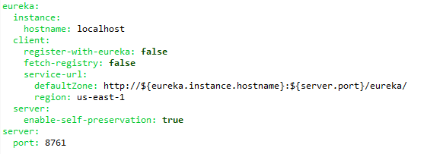
Eureka
yml file configuration for Eureka Server
By default, application configuration can be defined using a Java properties file at the root of the application’s classpath named application.properties. A preferred approach, however, is to use YAML configuration, which gives structure and depth to nested configuration.

Slide 27
Eureka
yml configuration | Description
eureka: instance: hostname: <HOSTNAME> | Host name by which Eureka server is available. Config server can be used to configure this value
server: port: 8761 | Port number on which Eureka server is running. This can be populated by using Config server or specified at deployment time. Eg. server.port=8081 By adding these parameters it will start the service on port 8081, which will override the configuration of application.yml file.
server: enable-self-preservation: false | This feature of the Eureka server makes the assumption clients is sending their heartbeat every 30 seconds - and this is not configurable. Eureka Server has a protection feature: in case a certain number of Instances fail to send heartbeats in a determined time interval, the Server will not remove them from the registry. It considers that a network partition occurred and will wait for these Instances to come back

Slide 28
Eureka
Steps to configure Eureka Client
Create a new Gradle Java Project
Import following dependencies in build.gradle file
compile ('org.springframework.cloud:spring-cloud-starter-eureka:1.0.3.RELEASE')
compile ('org.springframework.boot:spring-boot-starter-web:1.2.6.RELEASE')
Create a new java class Application having public static void method
Use following annotation in this class
@SpringBootApplication
@EnableEurekaClient
Create a Rest Controller class having business logic.
Specify port number and eureka server url i.e. http://localhost:8761/eureka/ in the application.yml file under src/main/resources folder of the project.
Specify the application name in the bootstrap.yml file under src/main/resources folder of the project.
Build the application so that it will download all the necessary dependency from central repository
bootRun the application.

Slide 29
Eureka
package com.cg;
import org.springframework.boot.SpringApplication;
import org.springframework.boot.autoconfigure.SpringBootApplication;
import org.springframework.cloud.netflix.eureka.EnableEurekaClient;
@EnableEurekaClient
@SpringBootApplication
public class Application {
public static void main(String[] args) {
SpringApplication.run(Application.class, args);
}
}
@EnableDiscoveryClient
It tells the application that we are treating this application as Eureka Client.

Slide 30
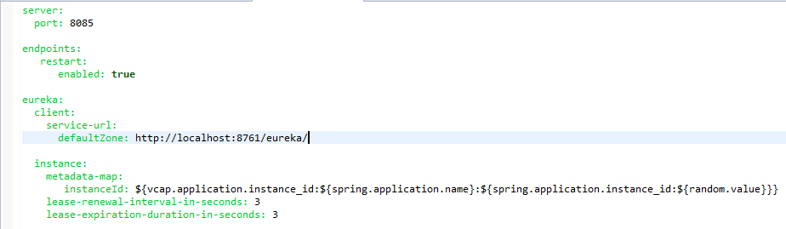
Eureka
application.yml file configuration for Eureka Client

Slide 31

Eureka
bootstrap.yml file configuration for Eureka Client

Slide 32
Eureka
Steps to access Eureka Dashboard
Access http://localhost:8761 URL. Host name and port number should be the similar which is configured in application.yml file
Steps to access REST representation dashboard of registered services
Access http://localhost:8761/eureka/apps URL. Host name and port number should be the similar which is configured in application.yml file

Slide 33
Spring Cloud Config
Spring Cloud Config provides server and client-side support for externalized configuration in a distributed system. With the Config Server you have a central place to manage external properties for applications across all environments.
Steps to configure Spring Cloud Config Server
Create a new Gradle Java Project
Import following dependencies in build.gradle file
compile ('org.springframework.boot:spring-boot-starter-web:1.2.6.RELEASE')
compile ('org.springframework.cloud:spring-cloud-config-server:1.0.2.RELEASE‘)
compile ('org.springframework.cloud:spring-cloud-starter-eureka:1.0.3.RELEASE')
Create a new java class ConfigServerApplication having public static void method
Use following annotations in this class and register the service with eureka
@EnableEurekaClient
@EnableConfigServer
@SpringBootApplication
Build the application so that it will download all the necessary dependency from central repository and bootRun the application.

Slide 34
Spring Cloud Config
package com.cg;
import org.springframework.boot.SpringApplication;
import org.springframework.boot.autoconfigure.SpringBootApplication;
import org.springframework.cloud.config.server.EnableConfigServer;
import org.springframework.cloud.netflix.eureka.EnableEurekaClient;
@EnableEurekaClient
@EnableConfigServer
@SpringBootApplication
public class ConfigServerApplication {
public static void main(String[] args) {
SpringApplication.run(ConfigServerApplication.class, args);
}
}
@EnableConfigServer: This annotation embeds the server in a Spring Boot application

Slide 35
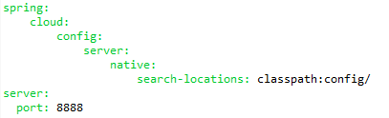

Spring Cloud Config
yml configuration for spring cloud config server
The spring-cloud-config-server-native-search-locations indicates the folder location within the project where the configuration files are present.
service-name.properties which holds the properties for that service at config location

Slide 36
Spring Cloud Config
Steps to configure Spring Cloud Config Client
Create a new Gradle Java Project
Import following dependencies in build.gradle file
compile ('org.springframework.boot:spring-boot-starter-web:1.2.6.RELEASE')
compile ('org.springframework.cloud:spring-cloud-config-client:1.0.3.RELEASE')
compile ('org.springframework.cloud:spring-cloud-starter-eureka:1.0.3.RELEASE')
Create a new java class Application having public static void method
Use following annotations in this class and register the service with Eureka
@SpringBootApplication
@EnableEurekaClient
Configure the application.yml to hold placeholders for the values declared in the spring config
Configure the spring cloud config server URL in the bootstrap.yml
Build the application so that it will download all the necessary dependency from central repository and bootRun the application.
A Spring Boot application that depends on spring-cloud-config-client when runs will pick up the external configuration from the config server it is running.

Slide 37
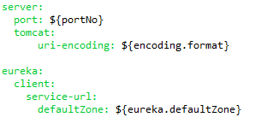
Spring Cloud Config
application.yml configuration for spring cloud config client
It will search for these properties in service-name.properties file in the spring cloud config server project.

Slide 38

Spring Cloud Config
bootstrap.yml configuration for spring cloud config client
The port number and the hostname should match that of the spring cloud config server.
The spring-application-name (‘service-name’) should match the name of the properties file which is present at the location specified by spring-cloud-config-server-native-search-locations in the spring cloud config server project described earlier.

Slide 39
Spring Cloud Config
Configuring for different environments
Properties file can be created for different environments with the same spring application name and the environment name separated by ‘-’
For dev: service-name-dev.properties
For qa: service-name-qa.properties
For prod: service-name.properties
Running the application with the parameter ‘--spring.cloud.config.profile=dev’ will pick up the respective environment properties file.

Slide 40
Zuul
Zuul is a JVM based router and server side load balancer by Netflix. Zuul’s rule engine allows rules and filters to be written in essentially any JVM language, with built in support for Java and Groovy.
Netflix uses Zuul for the following:
Authentication
Insights
Stress Testing
Canary Testing
Dynamic Routing
Service Migration
Load Shedding
Security
Static Response handling
Active traffic management

Slide 41
Zuul
Steps to configure Zuul
Create a new Gradle Java Project
Import following dependencies in build.gradle file
compile ('org.springframework.boot:spring-boot-starter-web:1.2.6.RELEASE')
compile ('org.springframework.cloud:spring-cloud-starter-zuul:1.0.3.RELEASE‘)
compile ('org.springframework.cloud:spring-cloud-starter-bus-amqp‘)
compile ('org.springframework.cloud:spring-cloud-starter-eureka:1.0.3.RELEASE')
Create a new java class Application having public static void method
Use following annotations in this class
@EnableZuulProxy
@SpringBootApplication
Configure the application.yml which defines the routes for the zuul
Build the application so that it will download all the necessary dependency from central repository and bootRun the application.

Slide 42
Zuul
package com.capgemini.gateway.app;
import org.springframework.boot.SpringApplication;
import org.springframework.boot.autoconfigure.SpringBootApplication;
import org.springframework.cloud.netflix.zuul.EnableZuulProxy;
@EnableZuulProxy
@SpringBootApplication
public class GatewayApp {
public static void main(String... args) {
SpringApplication.run(GatewayApp.class, args);
}
}
@EnableZuulProxy: Annotate a Spring Boot main class with @EnableZuulProxy, and this forwards local calls to the appropriate service. The proxy uses Ribbon to locate an instance to forward to.

Slide 43
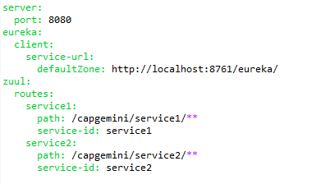
Zuul
application.yml configuration for Zuul
When Zuul is up and running on the Eureka server it will get the details of all the services registered on Eureka and map the paths specified in its application.yml with the respective services. So, when a Zuul URL is hit with an appropriate path for calling the service it will route it to the respective service.

Slide 44
Zuul
Zuul also acts as a server side load balancer. If multiple instances of the same service are deployed at different ports then Zuul uses round robin technique to load balance the services.
To deploy multiple instances of the same service, either edit the port number in application.yml of that service or execute the following command with different port numbers in command-line:
java -jar service-name.jar --server.port=port_number

Slide 45
Hystrix
Hystrix is designed to do the following:
Give protection from and control over latency and failure from dependencies accessed (typically over the network) via third-party client libraries.
Stop cascading failures in a complex distributed system.
Fail fast and rapidly recover.
Fallback and gracefully degrade when possible.
Enable near real-time monitoring, alerting, and operational control.
Hystrix has built in the following defaults:
Timeout for every request to an external system (default: 1000 ms)
Limit of concurrent requests for external system (default: 10)
Circuit breaker to avoid further requests (default: when more than 50% of all requests fail)
Retry of a single request after circuit breaker has triggered (default: every 5 seconds)
Interfaces to retrieve runtime information on request and aggregate level (there’s even a ready-to-use realtime dashboard for it)

Slide 46
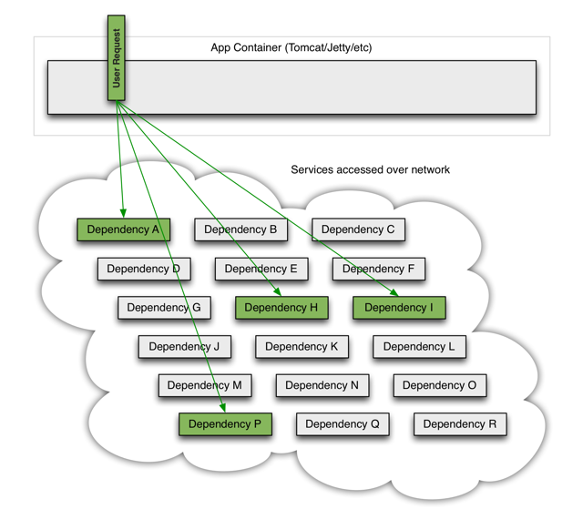
Hystrix
When everything is healthy the request flow can look like this:

Slide 47
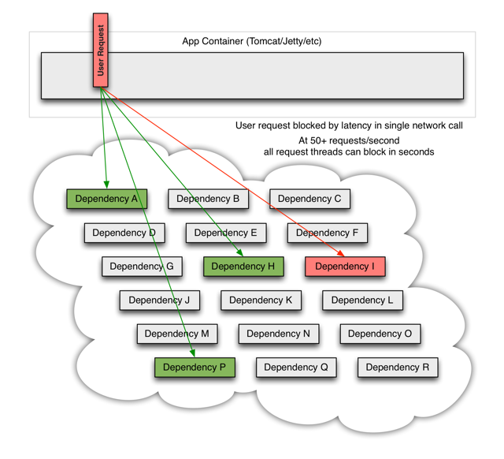
Hystrix
When one of many backend systems becomes latent it can block the entire user request:
With high volume traffic a single backend dependency becoming latent can cause all resources to become saturated in seconds on all servers.

Slide 48
Hystrix
When one of many backend systems becomes latent it can block the entire user request:

Slide 49
Hystrix
What Design Principles Underlie Hystrix?
Preventing any single dependency from using up all container (such as Tomcat) user threads.
Shedding load and failing fast instead of queueing.
Providing fallbacks wherever feasible to protect users from failure.
Using isolation techniques (such as bulkhead, swimlane, and circuit breaker patterns) to limit the impact of any one dependency.
Optimizing for time-to-discovery through near real-time metrics, monitoring, and alerting
Optimizing for time-to-recovery by means of low latency propagation of configuration changes and support for dynamic property changes in most aspects of Hystrix, which allows you to make real-time operational modifications with low latency feedback loops.
Protecting against failures in the entire dependency client execution, not just in the network traffic.

Slide 50
Hystrix
How Does Hystrix Accomplish Its Goals?
Wrapping all calls to external systems (or “dependencies”) in a HystrixCommand object which typically executes within a separate thread.
Timing-out calls that take longer than thresholds you define.
Maintaining a small thread-pool (or semaphore) for each dependency; if it becomes full, requests destined for that dependency will be immediately rejected instead of queued up.
Measuring successes, failures (exceptions thrown by client), timeouts, and thread rejections.
Tripping a circuit-breaker to stop all requests to a particular service for a period of time, either manually or automatically if the error percentage for the service passes a threshold.
Performing fallback logic when a request fails, is rejected, times-out, or short-circuits.
Monitoring metrics and configuration changes in near real-time.

Slide 51
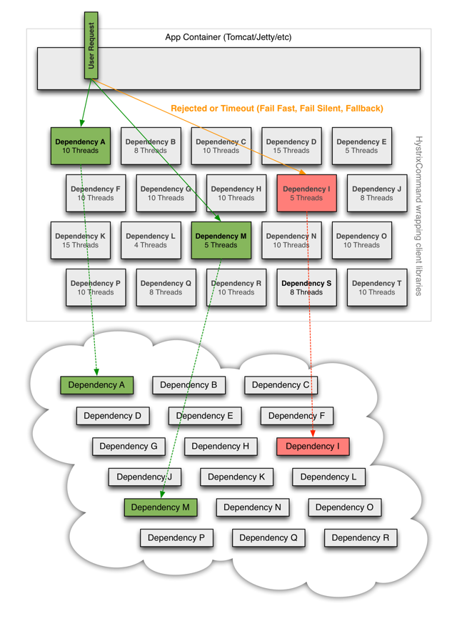
Hystrix

Slide 52
Hystrix
Enabling Hystrix in Your Application
Hystrix can be used either inside a service or at the service client.
Inside a service, Hystrix can be used to monitor individual operations and provide fallback logic for each operation.
At a service client, Hystrix can be used to monitor whether the service itself is available. In case of service failure, Hystrix will open the circuit breaker and prevent any further requests to the service.
Annotations Required:
@EnableCircuitBreaker – Annotate your spring boot application class with this to enable the circuit breaker.
@HystrixCommand – Wrap your methods with this annotation. This allows hystrix to monitor failures. It also allows specifying a fallback method which can be used to provide fallback logic in case of failures.
Dependencies Required:
org.springframework.cloud:spring-cloud-starter-hystrix
org.springframework.cloud:spring-cloud-netflix-hystrix-amqp
com.netflix.hystrix:hystrix-javanica

Slide 53
Hystrix
package com.cg;
import org.springframework.boot.SpringApplication;
import org.springframework.boot.autoconfigure.SpringBootApplication;
import org.springframework.cloud.client.circuitbreaker.EnableCircuitBreaker;
@EnableCircuitBreaker
@SpringBootApplication
public class Application {
public static void main(String[] args) {
SpringApplication.run(Application.class, args);
}
}

Slide 54
Hystrix
@Component
public class StoreIntegration {
@HystrixCommand(fallbackMethod = "defaultStores")
public Object getStores(Map<String, Object> parameters) {
//do stuff that might fail
}
public Object defaultStores(Map<String, Object> parameters) {
return /* something useful */;
}
}

Slide 55
Hystrix
Hystrix Dashboard
Hystrix provides a ready to use dashboard to monitor your application in real time. To enable a dashboard, simply create a spring boot application and annotate it with @EnableHystrixDashboard.
Dependencies:
compile("org.springframework.cloud:spring-cloud-starter-hystrix")
compile("org.springframework.cloud:spring-cloud-starter-hystrix-dashboard")
compile("com.netflix.hystrix:hystrix-metrics-event-stream:1.4.10")
Dashboard URL: http://localhost:7979/hystrix

Slide 56
Hystrix
package com.cg;
import org.springframework.boot.autoconfigure.SpringBootApplication;
import org.springframework.boot.builder.SpringApplicationBuilder;
import org.springframework.cloud.netflix.hystrix.dashboard.EnableHystrixDashboard;
@EnableHystrixDashboard
@SpringBootApplication
public class HystrixDashboard {
public static void main(String[] args) {
new SpringApplicationBuilder(HystrixDashboard.class).web(true).run(args);
}
}

Slide 57
Turbine
Turbine is a tool for aggregating streams of Server-Sent Event (SSE) JSON data into a single stream.
Steps to configure Turbine
Create a new Gradle Java Project
Import following dependencies in build.gradle file
compile ('org.springframework.boot:spring-boot-starter-web:1.2.6.RELEASE')
compile('org.springframework.cloud:spring-cloud-starter-turbine-amqp:1.0.0.RELEASE')
Create a new java class Application having public static void method
Use following annotations in this class
@EnableTurbineAmqp
@SpringBootApplication
Turbine needs the RabbitMQ server to be up and running. So start the RabbitMQ server.
Build the application so that it will download all the necessary dependency from central repository and bootRun the application.

Slide 58
Turbine
package com.cg;
import org.springframework.boot.SpringApplication;
import org.springframework.boot.autoconfigure.SpringBootApplication;
import org.springframework.cloud.netflix.turbine.amqp.EnableTurbineAmqp;
@EnableTurbineAmqp
@SpringBootApplication
public class TurbineApplication {
public static void main(String[] args) {
SpringApplication.run(TurbineApplication.class, args);
}
}

Slide 59
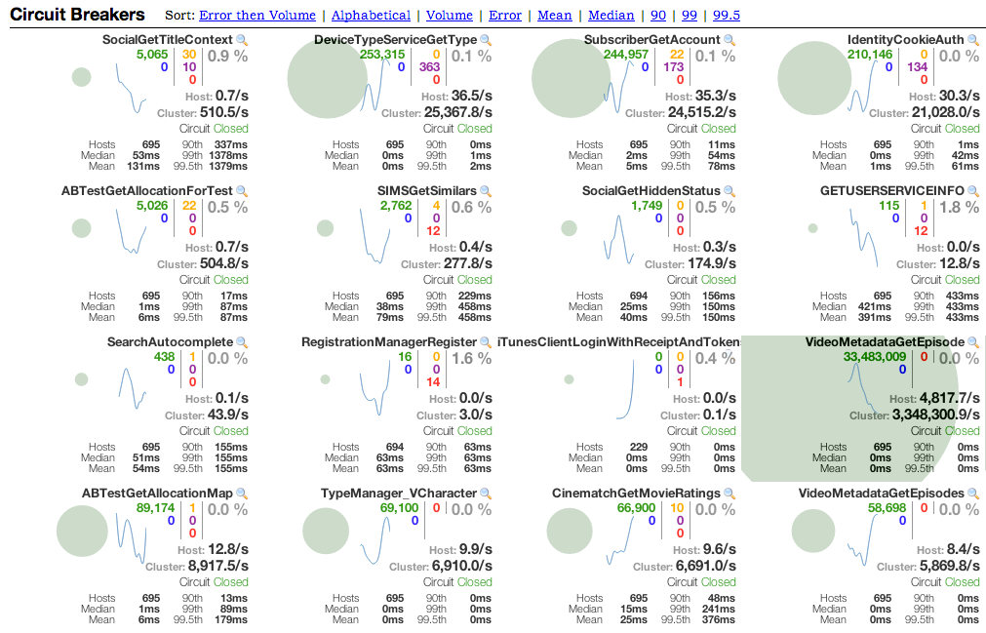
Turbine
To monitor an aggregate stream via Turbine the URL would be like this:
http://hostname:port/turbine/turbine.stream
Snapshot of the dashboard being used to monitor several systems across the company.

Slide 60
Configure microservices with Spring Cloud Netflix
Setup Eureka Server.
Create spring cloud config server.
Create spring boot microservices and register it on the eureka server.
Externalize the configurations of all the services on the spring cloud config server.
Setup Zuul for routing and load balancing.
Setup Hystrix Dashboard.
Create appropriate Hystrix fallbacks and enable circuit breakers for each microservice.
Setup Turbine Stream Aggregator (RabbitMQ needs to be started for Turbine to be enabled).
Start all the servers and serives in the same order as above. Multiple instances of the microservices can be started to enable load balancing.

Slide 61
Thank You
Date: 27th May, 2016

